Slide 2
Agent design
The environment type largely determines the agent design
Fully/partially observable => agent requires memory (internal state)
Discrete/continuous => agent may not be able to enumerate all states
Stochastic/deterministic => agent may have to prepare for contingencies
Single-agent/multi-agent => agent may need to behave randomly

Slide 3
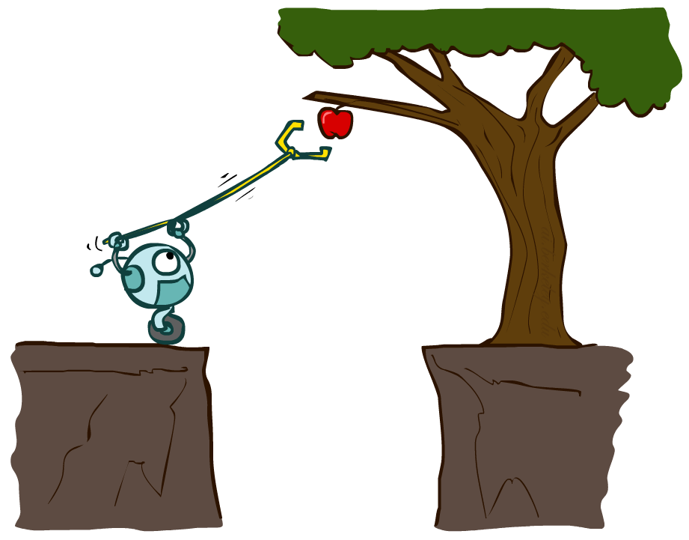
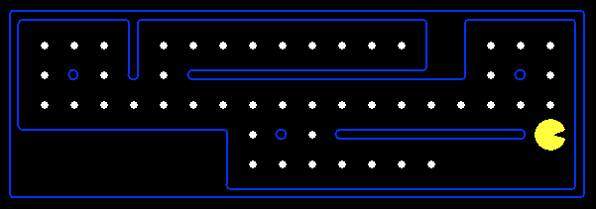
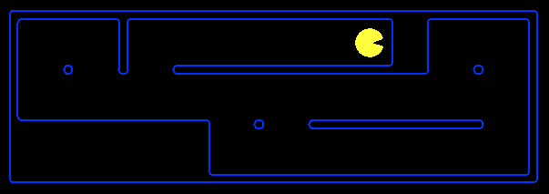
Planning Agents
Planning agents:
Ask “what if”
Decisions based on (hypothesized) consequences of actions
Must have a model of how the world evolves in response to actions
Must formulate a goal (test)
Consider how the world WOULD BE
Optimal vs. complete planning
Planning vs. replanning
[Demo: re-planning (L2D3)]
[Demo: mastermind (L2D4)]

Slide 4
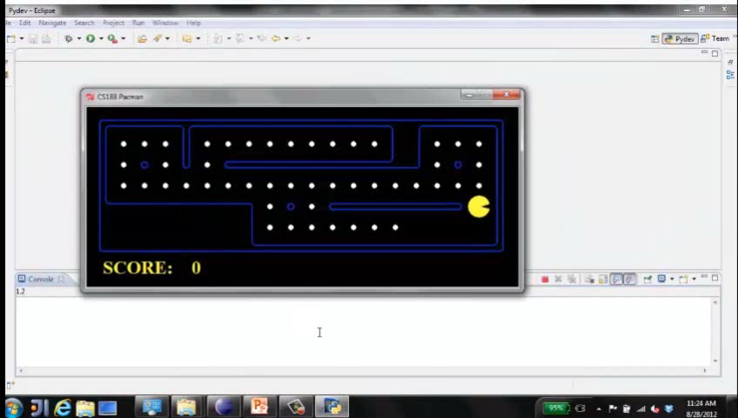
Video of Demo Replanning

Slide 5
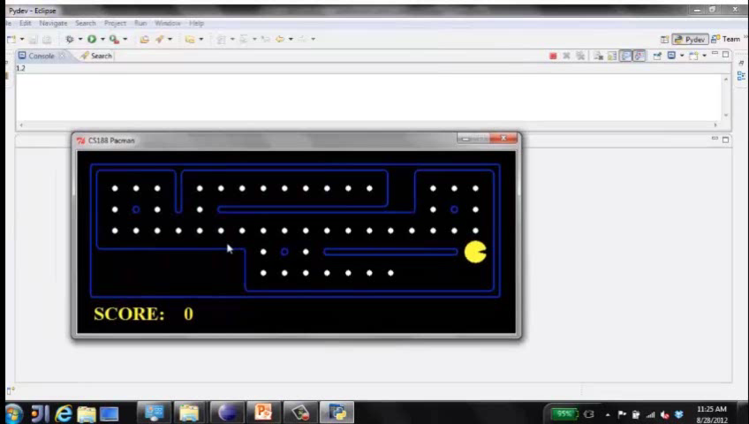
Video of Demo Mastermind

Slide 6

Search Problems

Slide 7
Problem solving agents
Uses atomic representations – states are considered as whole with no internal structure visible to the problem
Goal formulation – based on the current situation and the agent’s performance measure
Problem Formulation – what actions and states to consider given a goal.
Environment is observable, discrete, deterministic
Process of looking for a sequence of actions is called search
Search takes a problem as input and returns a solution in the form of an action
Actions are carried out in the execution phase

Slide 8
Search problems
Initial state - starting point
Actions – description of the possible actions available
Applicable actions – From a state ‘s’ what actions are possible
Transition model – A description of what each action does
Successor – state reachable from a given state
State space – set of all states reachable from the initial state by any sequence of actions
Graph – Nodes are states and the links between the nodes are actions
Path – sequence of states

Slide 9
Goal test – test to verify whether a state is goal
Path cost – Function to assign a numeric cost to each path
Solution – leads from start state to final state

Slide 10

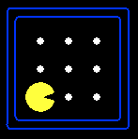





Search Problems
A search problem consists of:
A state space
A successor function
(with actions, costs)
A start state and a goal test
A solution is a sequence of actions (a plan) which transforms the start state to a goal state
“N”, 1.0
“E”, 1.0
Notes:
Often comes back on exams
Goal test – sometimes more than one state that satisfies having achieved the goal, for example, “eat all the dots”
Abstraction

Slide 11

Search Problems Are Models

Slide 12
Example: Traveling in Romania
State space:
Cities
Successor function:
Roads: Go to adjacent city with cost = distance
Start state:
Arad
Goal test:
Is state == Bucharest?
Solution?

Slide 18
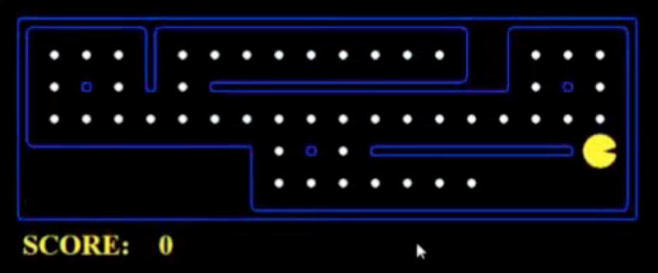
What’s in a State Space?
The world state includes every last detail of the environment
A search state keeps only the details needed for planning (abstraction)
Problem: Pathing
States: (x,y) location
Actions: NSEW
Successor: update location only
Goal test: is (x,y)=END
Problem: Eat-All-Dots
States: {(x,y), dot booleans}
Actions: NSEW
Successor: update location and possibly a dot boolean
Goal test: dots all false
Notes:
Wrong example for “eat-all-dots”: (x, y, dot count)

Slide 19
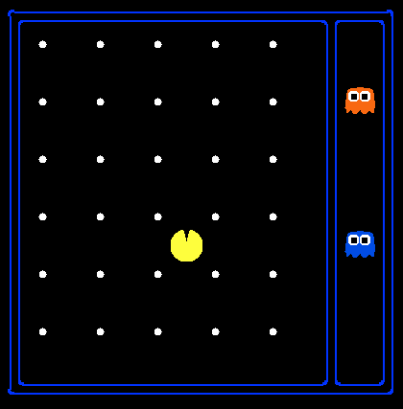
State Space Sizes?
World state:
Agent positions: 120
Food count: 30
Ghost positions: 12
Agent facing: NSEW
How many
World states?
120x(2³⁰)x(12²)x4
States for pathing?
120
States for eat-all-dots?
120x(2³⁰)
Notes:
90 * (2^30-1) + 30 * 2^29 = 145 billion
2^29 = 536 870 912

Slide 20
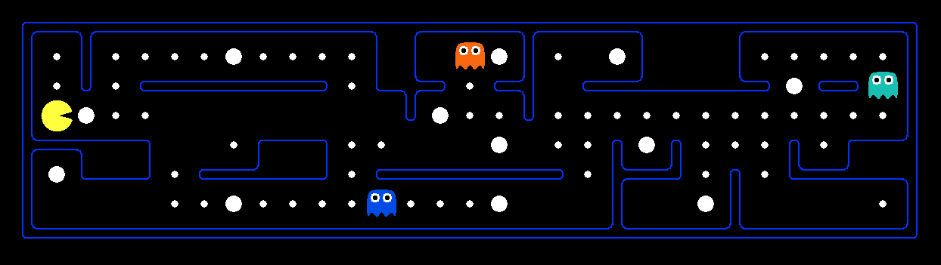
Quiz: Safe Passage
Problem: eat all dots while keeping the ghosts perma-scared
What does the state space have to specify?
(agent position, dot booleans, power pellet booleans, remaining scared time)

Slide 21
Agent design
The environment type largely determines the agent design
Fully/partially observable => agent requires memory (internal state)
Discrete/continuous => agent may not be able to enumerate all states
Stochastic/deterministic => agent may have to prepare for contingencies
Single-agent/multi-agent => agent may need to behave randomly

Slide 22
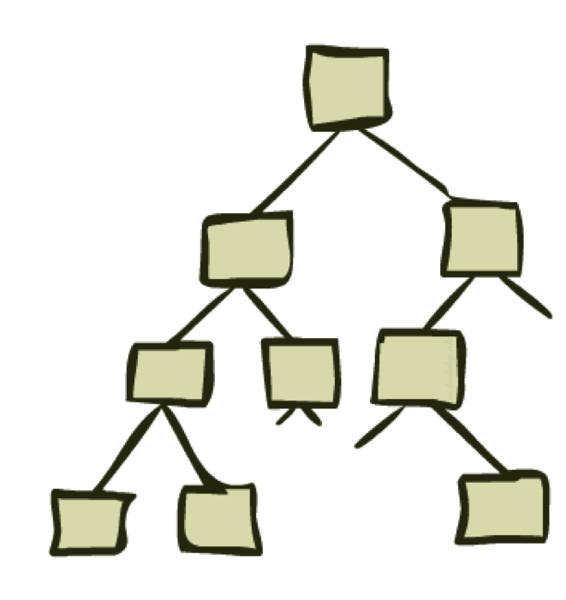
State Space Graphs and Search Trees

Slide 23
State Space Graphs
State space graph: A mathematical representation of a search problem
Nodes are (abstracted) world configurations
Arcs represent successors (action results)
The goal test is a set of goal nodes (maybe only one)
In a state space graph, each state occurs only once!
We can rarely build this full graph in memory (it’s too big), but it’s a useful idea

Slide 24
State Space Graphs
State space graph: A mathematical representation of a search problem
Nodes are (abstracted) world configurations
Arcs represent successors (action results)
The goal test is a set of goal nodes (maybe only one)
In a state space graph, each state occurs only once!
We can rarely build this full graph in memory (it’s too big), but it’s a useful idea
a
G
b
c
e
d
f
S
h
p
q
r
Tiny state space graph for a tiny search problem

Slide 25
Search Trees
This is now / start
“N”, 1.0
“E”, 1.0
Possible futures
A search tree:
A “what if” tree of plans and their outcomes
The start state is the root node
Children correspond to successors
Nodes show states, but correspond to PLANS that achieve those states
For most problems, we can never actually build the whole tree
Notes:
Different plans that achieve the same state, will be different nodes in the tree.

Slide 26
State Space Graphs vs. Search Trees
State Space Graph
Each NODE in in the search tree is an entire PATH in the state space graph.
Search Tree
S
a
G
d
e
p
b
c
q
b
c
e
h
r
d
e
f
a
a
h
r
p
q
f
S
h
We construct both on demand – and we construct as little as possible.
p
q
f
q
c
G
p
q
r
q
c
G
a
a

Slide 27

Quiz: State Space Graphs vs. Search Trees
Consider this 4-state graph:
How big is its search tree (from S)?
a
S
G
b
Important: Lots of repeated structure in the search tree!

Slide 28
Quiz: State Space Graphs vs. Search Trees
Consider this 4-state graph:
How big is its search tree (from S)?
a
S
G
b

Slide 29
State Space Graphs vs. Search Trees
Consider this 4-state graph:
How big is its search tree (from S)?
a
s
a
b
S
G
b
G
a
G
b
a
G
b
G
…
…
Important: Lots of repeated structure in the search tree!

Slide 30
Tree Search

Slide 31
Search Example: Romania

Slide 32
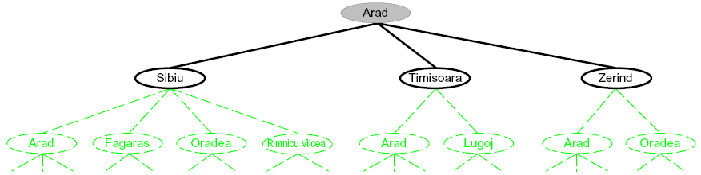
Searching with a Search Tree
Search:
Expand out potential plans (tree nodes)
Maintain a fringe of partial plans under consideration
Try to expand as few tree nodes as possible

Slide 33
General Tree Search
Important ideas:
Fringe
Expansion
Exploration strategy
Main question: which fringe nodes to explore?

Slide 34
Example: Tree Search
a
G
b
c
d
e
f
S
h
p
q
r
Notes:
Left: show tree
Right: fringe

Slide 35
Example: Tree Search
a
G
b
c
e
d
e
d
f
f
S
h
p
r
q
r
S
s
s → d
s → e
s → p
s → d → b
s → d → c
s → d → e
s → d → e → h
s → d → e → r
s → d → e → r → f
s → d → e → r → f → c
s → d → e → r → f → G
d
e
p
b
c
e
h
r
q
a
a
h
r
p
q
f
p
q
f
q
c
G
q
c
G
a
a

Slide 36

Depth-First Search

Slide 37
Depth-First Search
Strategy: expand a deepest node first
Implementation: Fringe is a LIFO stack
a
G
a
c
b
c
b
e
d
e
d
f
f
S
h
h
p
p
r
q
r
q
S
d
e
p
b
c
e
h
r
q
a
a
h
r
p
q
f
p
q
f
q
c
G
q
c
G
a
a

Slide 38
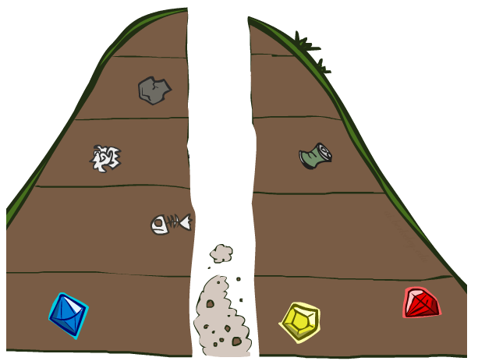
Search Algorithm Properties

Slide 39
Search Algorithm Properties
Complete: Guaranteed to find a solution if one exists?
Optimal: Guaranteed to find the least cost path?
Time complexity?
Space complexity?
Cartoon of search tree:
b is the branching factor
m is the maximum depth
solutions at various depths
Number of nodes in entire tree?
1 + b + b² + …. b^{m} = O(b^{m})
1 node
b
…
b nodes
b² nodes
m tiers
b^{m} nodes

Slide 40
Depth-First Search (DFS) Properties
What nodes DFS expand?
Some left prefix of the tree.
Could process the whole tree!
If m is finite, takes time O(b^{m})
How much space does the fringe take?
Only has siblings on path to root, so O(bm)
Is it complete?
m could be infinite, so only if we prevent cycles (more later)
Is it optimal?
No, it finds the “leftmost” solution, regardless of depth or cost
1 node
b
…
b nodes
b² nodes
m tiers
b^{m} nodes

Slide 41
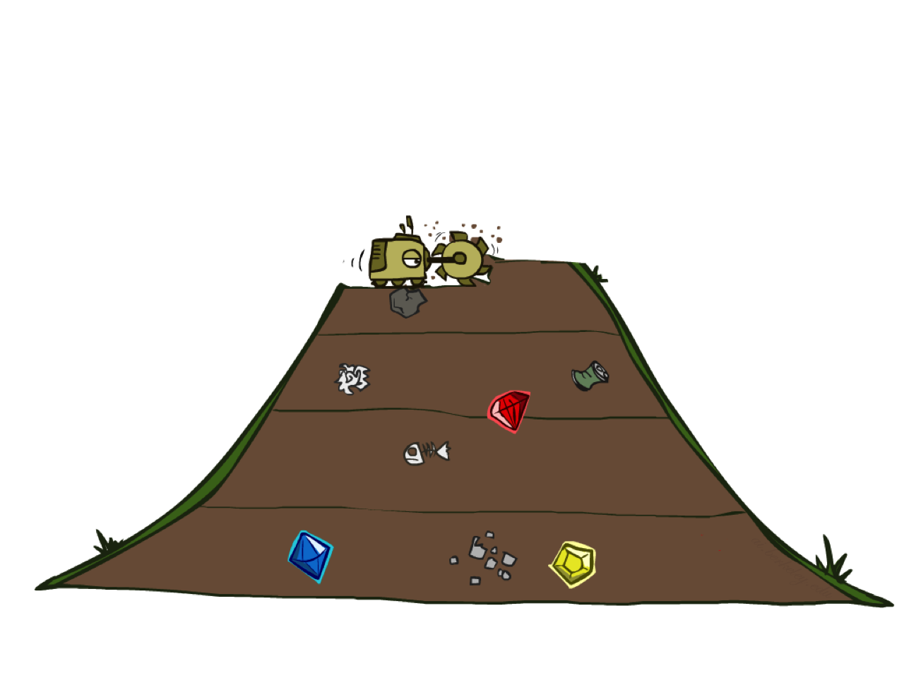
Breadth-First Search

Slide 42
Breadth-First Search
Strategy: expand a shallowest node first
Implementation: Fringe is a FIFO queue
a
G
b
c
d
e
f
S
h
p
q
r
S
d
e
p
Search
Tiers
b
c
e
h
r
q
a
a
h
r
p
q
f
p
q
f
q
c
G
q
c
G
a
a

Slide 43
Breadth-First Search (BFS) Properties
What nodes does BFS expand?
Processes all nodes above shallowest solution
Let depth of shallowest solution be s
Search takes time O(b^{s})
How much space does the fringe take?
Has roughly the last tier, so O(b^{s})
Is it complete?
s must be finite if a solution exists, so yes!
Is it optimal?
Only if costs are all 1 (more on costs later)
1 node
b
…
b nodes
s tiers
b² nodes
b^{s} nodes
b^{m} nodes

Slide 44
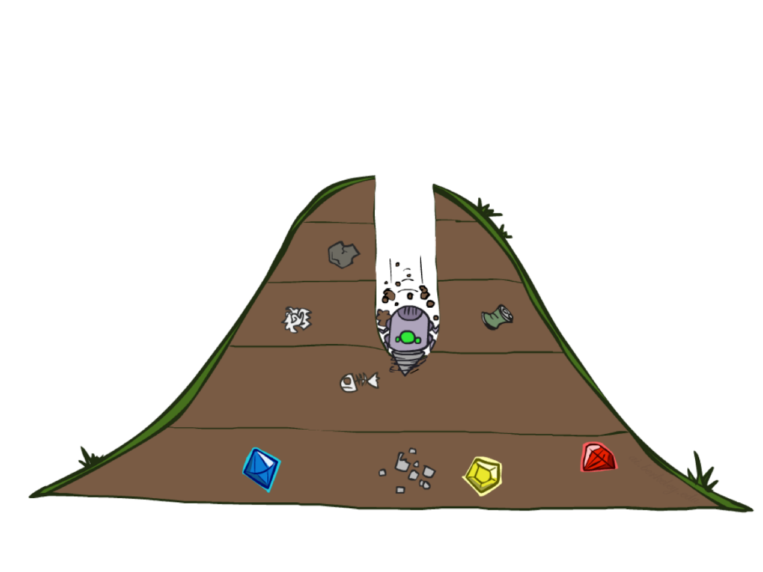
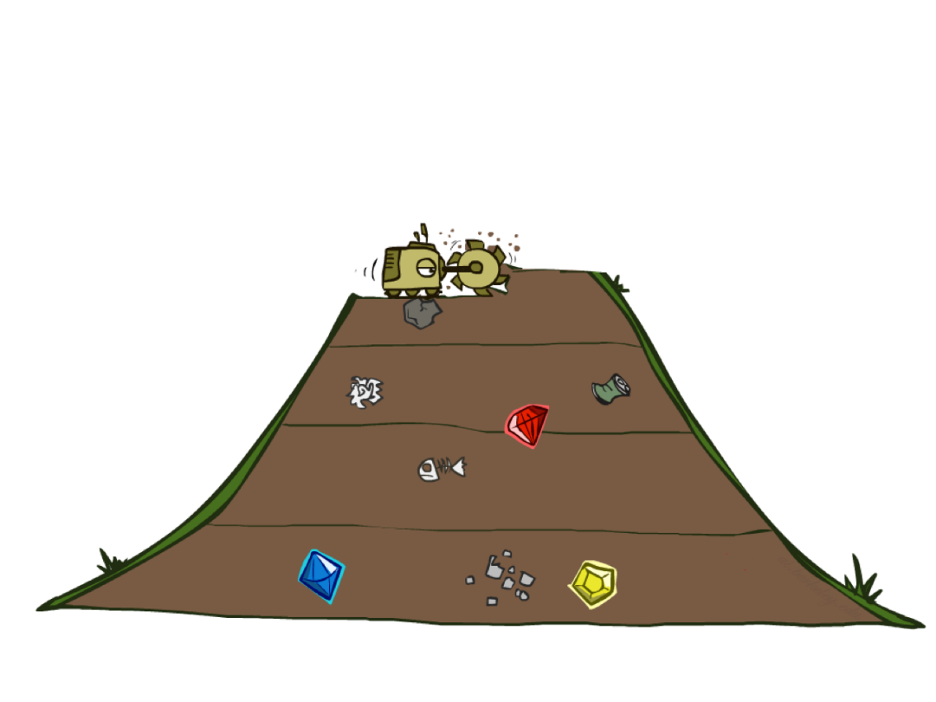
Quiz: DFS vs BFS

Slide 45
DFS vs BFS
When will BFS outperform DFS?
When will DFS outperform BFS?

Slide 46
Iterative Deepening
Idea: get DFS’s space advantage with BFS’s time / shallow-solution advantages
Run a DFS with depth limit 1. If no solution…
Run a DFS with depth limit 2. If no solution…
Run a DFS with depth limit 3. …..
Isn’t that wastefully redundant?
Generally most work happens in the lowest level searched, so not so bad!
b
…

Slide 47
Cost-Sensitive Search
a
GOAL
2
2
b
c
3
2
1
8
2
e
d
f
3
9
8
2
START
h
1
4
2
p
4
r
15
q
BFS finds the shortest path in terms of number of actions.
It does not find the least-cost path. We will now cover
a similar algorithm which does find the least-cost path.

Slide 48

Uniform Cost Search

Slide 49
Uniform Cost Search
2
G
a
Strategy: expand a cheapest node first:
Fringe is a priority queue (priority: cumulative cost)
b
c
1
8
2
2
e
3
d
f
9
8
2
S
h
1
1
p
q
r
15
0
S
d
3
e
9
p
1
b
4
e
5
h
17
r
11
q
16
c
11
Cost contours
a
6
a
h
13
r
7
p
q
f
p
q
f
8
q
c
G
q
c
a
11
G
10
a

Slide 50
Uniform Cost Search (UCS) Properties
What nodes does UCS expand?
Processes all nodes with cost less than cheapest solution!
If that solution costs C* and arcs cost at least ε , then the “effective depth” is roughly C*/ε
Takes time O(b^{C*/ε}) (exponential in effective depth)
How much space does the fringe take?
Has roughly the last tier, so O(b^{C*/ε})
Is it complete?
Assuming best solution has a finite cost and minimum arc cost is positive, yes!
Is it optimal?
Yes! (Proof next lecture via A*)
b
c ≤ 1
…
C*/ε “tiers”
c ≤ 2
c ≤ 3

Slide 51
Uniform Cost Issues
Remember: UCS explores increasing cost contours
The good: UCS is complete and optimal!
The bad:
Explores options in every “direction”
No information about goal location
We’ll fix that soon!
…
c ≤ 1
c ≤ 2
c ≤ 3
Start
Goal
[Demo: empty grid UCS (L2D5)]
[Demo: maze with deep/shallow water DFS/BFS/UCS (L2D7)]

Slide 52
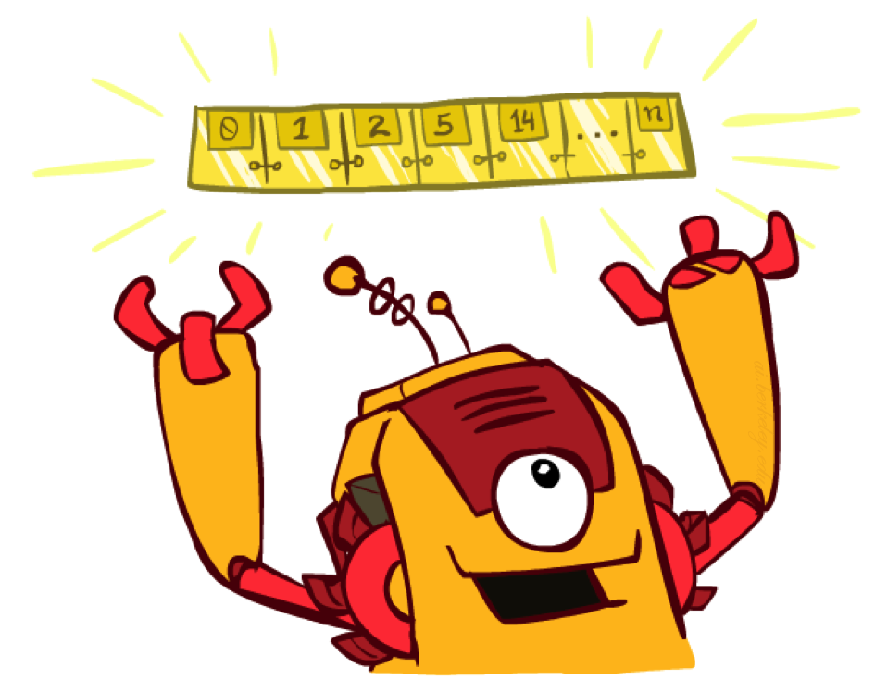
The One Queue
All these search algorithms are the same except for fringe strategies
Conceptually, all fringes are priority queues (i.e. collections of nodes with attached priorities)
Practically, for DFS and BFS, you can avoid the log(n) overhead from an actual priority queue, by using stacks and queues
Can even code one implementation that takes a variable queuing object

Slide 53
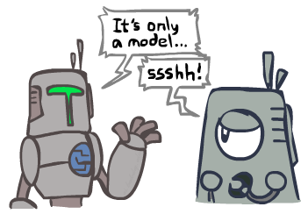
Search and Models
Search operates over models of the world
The agent doesn’t actually try all the plans out in the real world!
Planning is all “in simulation”
Your search is only as good as your models…

Slide 54
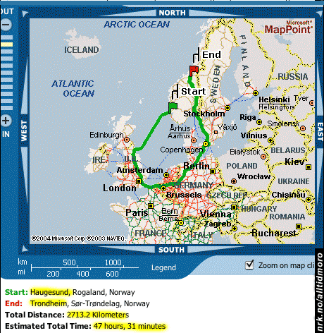
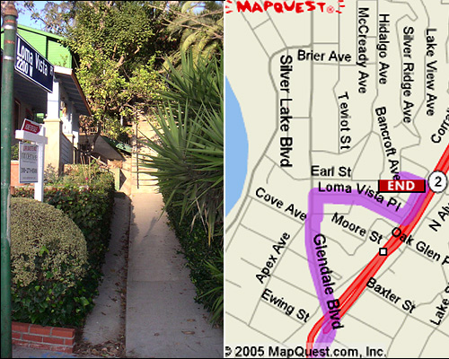

Search Gone Wrong?

Slide 55
Example: Pancake Problem
Cost: Number of pancakes flipped
Notes:
Gates, W. and Papadimitriou, C., "Bounds for Sorting by Prefix Reversal.", Discrete Mathematics. 27, 47-57, 1979.

Slide 56
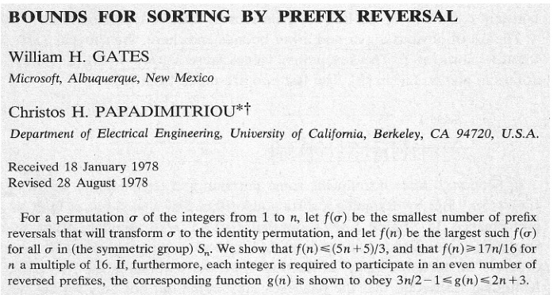
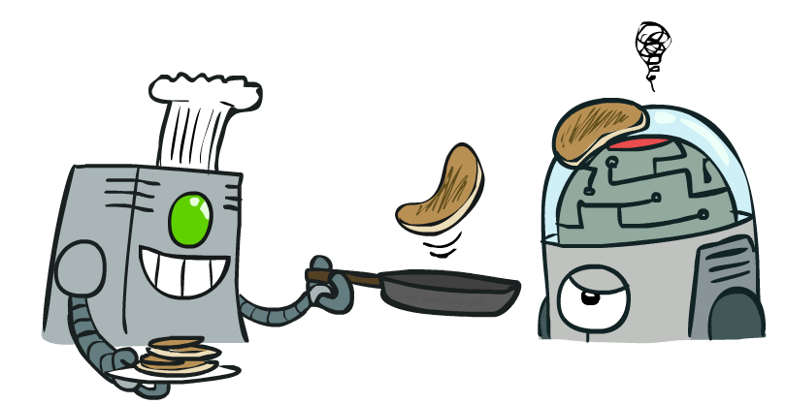
Example: Pancake Problem
Notes:
Gates, W. and Papadimitriou, C., "Bounds for Sorting by Prefix Reversal.", Discrete Mathematics. 27, 47-57, 1979.

Slide 57
Example: Pancake Problem
State space graph with costs as weights
4
2
3
2
3
4
3
4
2
3
2
2
4
3
Notes:
A* expanded 8100 ; Path cost = 33
UCS expanded 25263 . Path cost = 33
Greedy expanded 10 . Path cost = 41
[0, 7, 5, 3, 2, 1, 4, 6]
(7, 0, 5, 3, 2, 1, 4, 6)
(6, 4, 1, 2, 3, 5, 0, 7)
(3, 2, 1, 4, 6, 5, 0, 7)
(1, 2, 3, 4, 6, 5, 0, 7)
(5, 6, 4, 3, 2, 1, 0, 7)
(6, 5, 4, 3, 2, 1, 0, 7)
(0, 1, 2, 3, 4, 5, 6, 7)

Slide 58
General Tree Search
Action: flip top two Cost: 2
Action: flip all four Cost: 4
Path to reach goal:
Flip four, flip three
Total cost: 7
Notes:
You know exactly where you came from and how you got there, but you have no idea where you’re going. But, you’ll know it when you see it.

Slide 59
Uniform Cost Search
Strategy: expand lowest path cost
The good: UCS is complete and optimal!
The bad:
Explores options in every “direction”
No information about goal location
c ≤ 1
…
c ≤ 2
c ≤ 3
Start
Goal

Slide 62

Informed Search

Slide 63



Search Heuristics
A heuristic is:
A function that estimates how close a state is to a goal
Designed for a particular search problem
Examples: Manhattan distance, Euclidean distance for pathing
10
5
11.2

Slide 64
Example: Heuristic Function
h(x)

Slide 65
Example: Heuristic Function
Heuristic: the number of the largest pancake that is still out of place
3
h(x)
4
3
4
3
0
4
4
3
4
4
2
3
Notes:
A* expanded 8100 ; Path cost = 33
UCS expanded 25263 . Path cost = 33
Greedy expanded 10 . Path cost = 41
[0, 7, 5, 3, 2, 1, 4, 6]
(7, 0, 5, 3, 2, 1, 4, 6)
(6, 4, 1, 2, 3, 5, 0, 7)
(3, 2, 1, 4, 6, 5, 0, 7)
(1, 2, 3, 4, 6, 5, 0, 7)
(5, 6, 4, 3, 2, 1, 0, 7)
(6, 5, 4, 3, 2, 1, 0, 7)
(0, 1, 2, 3, 4, 5, 6, 7)

Slide 66

Greedy Search

Slide 67
Example: Heuristic Function
h(x)

Slide 69
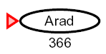

Greedy Search
Expand the node that seems closest…
What can go wrong?

Slide 70
Greedy Search
b
Strategy: expand a node that you think is closest to a goal state
Heuristic: estimate of distance to nearest goal for each state
A common case:
Best-first takes you straight to the (wrong) goal
Worst-case: like a badly-guided DFS
…
b
…
[Demo: contours greedy empty (L3D1)]
[Demo: contours greedy pacman small maze (L3D4)]
Notes:
For any search problem, you know the goal. Now, you have an idea of how far away you are from the goal.

Slide 71
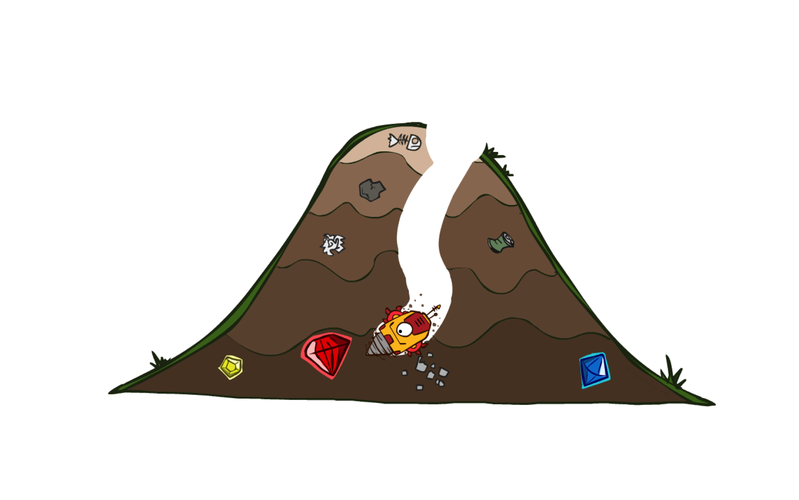
A* Search

Slide 72
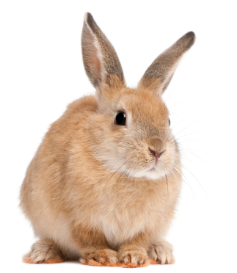
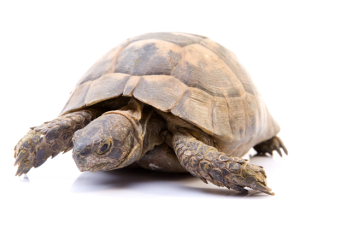
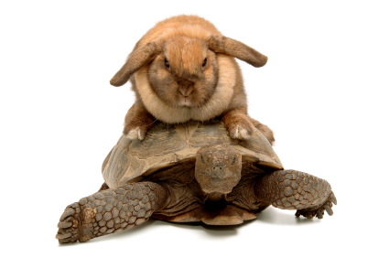
A* Search
UCS
Greedy
A*
Notes:
Notes: these images licensed from iStockphoto for UC Berkeley use.

Slide 75
Example: Heuristic Function
h(x)

Slide 78
Combining UCS and Greedy
Uniform-cost orders by path cost, or backward cost g(n)
Greedy orders by goal proximity, or forward cost h(n)
A* Search orders by the sum: f(n) = g(n) + h(n)
8
g = 0 h=6
S
e
h=1
g = 1 h=5
a
1
1
3
2
g = 2 h=6
g = 9 h=1
S
a
d
G
b
d
g = 4 h=2
e
h=6
1
h=5
h=2
h=0
1
g = 3 h=7
g = 6 h=0
g = 10 h=2
c
b
c
G
d
h=7
h=6
g = 12 h=0
G

Slide 79
When should A* terminate?
Should we stop when we enqueue a goal?
No: only stop when we dequeue a goal
h = 2
A
2
2
S
h = 3
h = 0
G
2
B
3
h = 1

Slide 80
Is A* Optimal?
h = 6
1
A
3
S
h = 7
G
h = 0
5
What went wrong?
Actual bad goal cost < estimated good goal cost
We need estimates to be less than actual costs!

Slide 81

Admissible Heuristics

Slide 82

Idea: Admissibility
Inadmissible (pessimistic) heuristics break optimality by trapping good plans on the fringe
Admissible (optimistic) heuristics slow down bad plans but never outweigh true costs

Slide 83


Admissible Heuristics
A heuristic h is admissible (optimistic) if:
where is the true cost to a nearest goal
Examples:
Coming up with admissible heuristics is most of what’s involved in using A* in practice.
4
15

Slide 84

Optimality of A* Tree Search

Slide 85


Optimality of A* Tree Search
Assume:
A is an optimal goal node
B is a suboptimal goal node
h is admissible
Claim:
A will exit the fringe before B
…

Slide 86


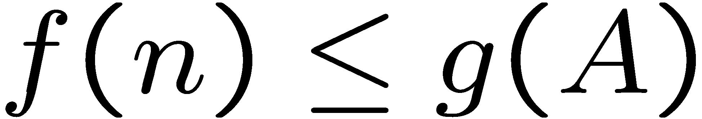
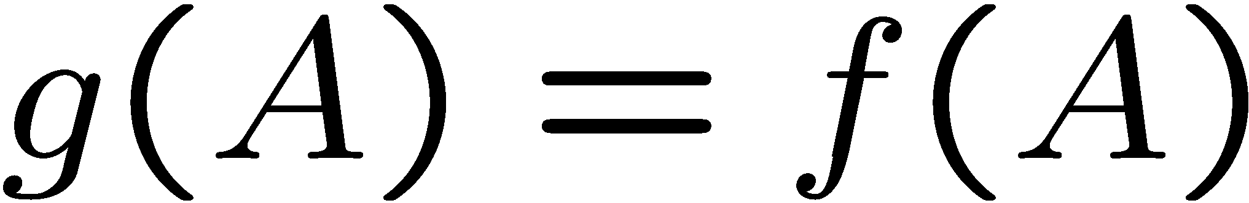
Optimality of A* Tree Search: Blocking
Proof:
Imagine B is on the fringe
Some ancestor n of A is on the fringe, too (maybe A!)
Claim: n will be expanded before B
f(n) is less or equal to f(A)
…
Definition of f-cost
Admissibility of h
h = 0 at a goal

Slide 87


Optimality of A* Tree Search: Blocking
Proof:
Imagine B is on the fringe
Some ancestor n of A is on the fringe, too (maybe A!)
Claim: n will be expanded before B
f(n) is less or equal to f(A)
f(A) is less than f(B)
…
B is suboptimal
h = 0 at a goal

Slide 88

Optimality of A* Tree Search: Blocking
Proof:
Imagine B is on the fringe
Some ancestor n of A is on the fringe, too (maybe A!)
Claim: n will be expanded before B
f(n) is less or equal to f(A)
f(A) is less than f(B)
n expands before B
All ancestors of A expand before B
A expands before B
A* search is optimal
…

Slide 89
Properties of A*

Slide 90
Properties of A*
Uniform-Cost
A*
b
b
…
…

Slide 91
UCS vs A* Contours
Uniform-cost expands equally in all “directions”
A* expands mainly toward the goal, but does hedge its bets to ensure optimality
Start
Goal
Start
Goal
[Demo: contours UCS / greedy / A* empty (L3D1)]
[Demo: contours A* pacman small maze (L3D5)]

Slide 92



Comparison
Greedy
Uniform Cost
A*

Slide 93
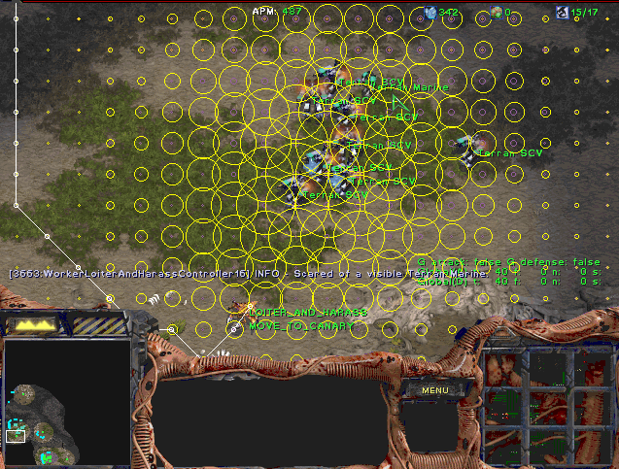
A* Applications

Slide 94
A* Applications
Video games
Pathing / routing problems
Resource planning problems
Robot motion planning
Language analysis
Machine translation
Speech recognition
…
[Demo: UCS / A* pacman tiny maze (L3D6,L3D7)]
[Demo: guess algorithm Empty Shallow/Deep (L3D8)]

Slide 95
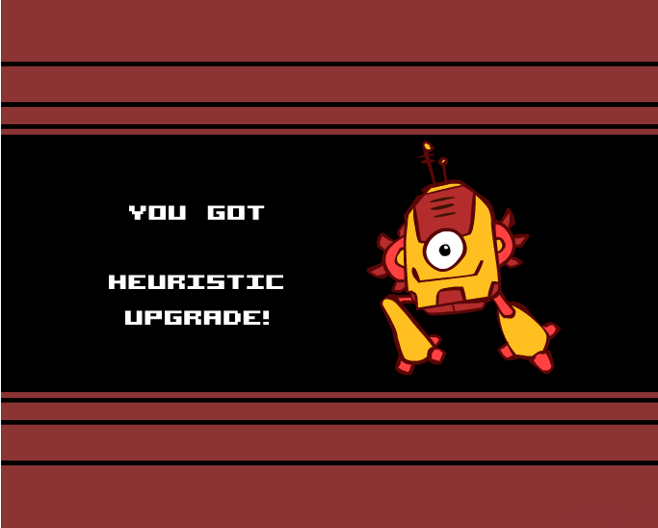
Creating Heuristics

Slide 96
Creating Admissible Heuristics
Most of the work in solving hard search problems optimally is in coming up with admissible heuristics
Often, admissible heuristics are solutions to relaxed problems, where new actions are available
Inadmissible heuristics are often useful too
366
15

Slide 97
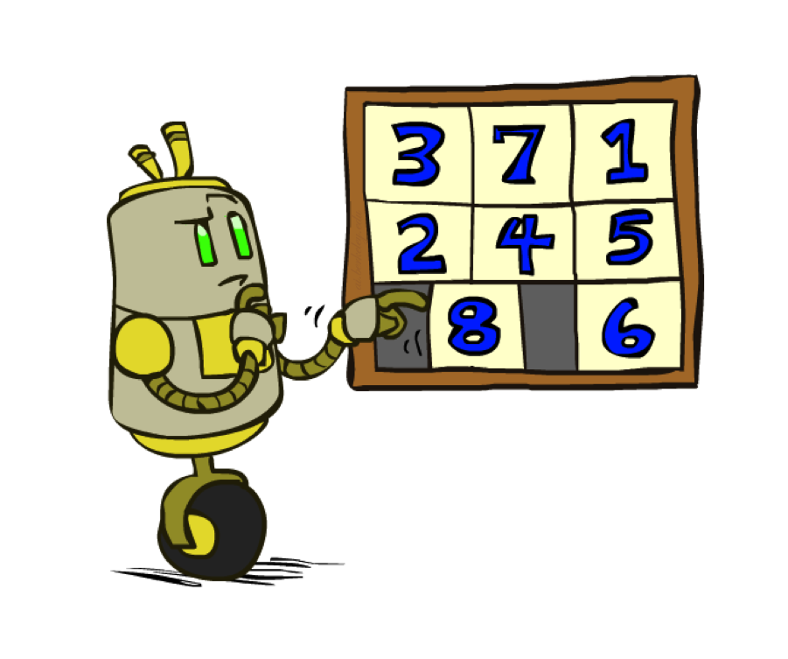
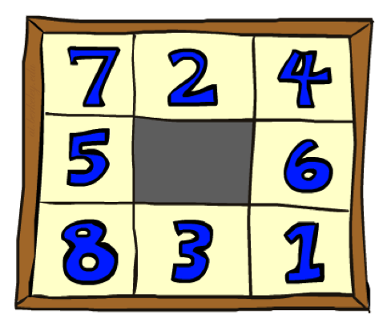
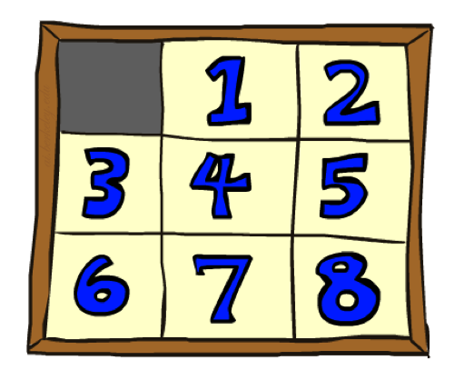
Example: 8 Puzzle
Start State
Actions
Goal State
What are the states?
How many states?
What are the actions?
How many successors from the start state?
What should the costs be?

Slide 98
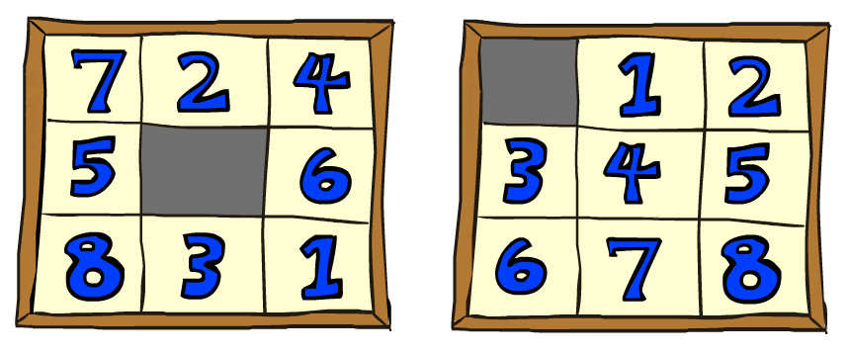
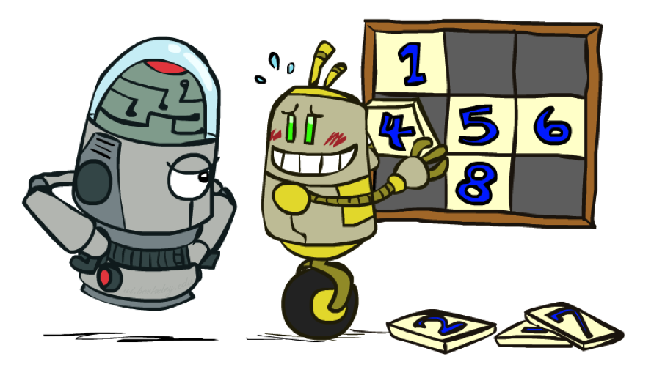
8 Puzzle I
Heuristic: Number of tiles misplaced
Why is it admissible?
h(start) =
This is a relaxed-problem heuristic
8
Start State
Goal State
 | Average nodes expanded when the optimal path has…
 | …4 steps | …8 steps | …12 steps
UCS | 112 | 6,300 | 3.6 x 10⁶
TILES | 13 | 39 | 227
Statistics from Andrew Moore

Slide 99
8 Puzzle II
What if we had an easier 8-puzzle where any tile could slide any direction at any time, ignoring other tiles?
Total Manhattan distance
Why is it admissible?
h(start) =
Start State
Goal State
 | Average nodes expanded when the optimal path has…
 | …4 steps | …8 steps | …12 steps
TILES | 13 | 39 | 227
MANHATTAN | 12 | 25 | 73
3 + 1 + 2 + … = 18

Slide 100
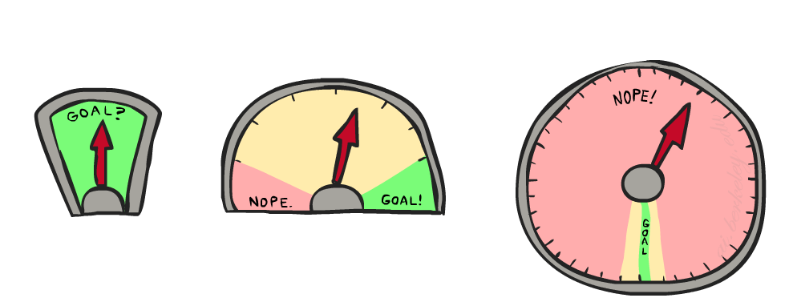
8 Puzzle III
How about using the actual cost as a heuristic?
Would it be admissible?
Would we save on nodes expanded?
What’s wrong with it?
With A*: a trade-off between quality of estimate and work per node
As heuristics get closer to the true cost, you will expand fewer nodes but usually do more work per node to compute the heuristic itself

Slide 105
Example: Heuristic Function
h(x)

Slide 108
Semi-Lattice of Heuristics

Slide 109

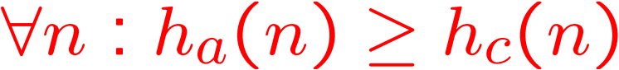
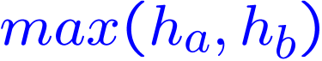

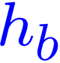


Trivial Heuristics, Dominance
Dominance: h_{a} ≥ h_{c} if
Heuristics form a semi-lattice:
Max of admissible heuristics is admissible
Trivial heuristics
Bottom of lattice is the zero heuristic (what does this give us?)
Top of lattice is the exact heuristic
Notes:
Semi-lattice: x <= y <-> x = x ^ y

Slide 110
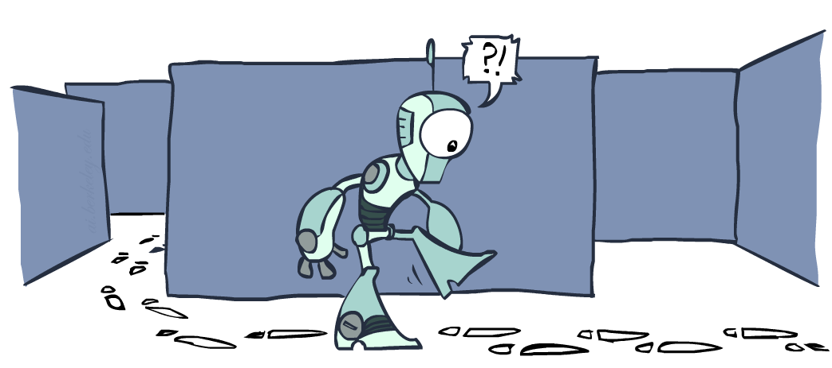
Graph Search

Slide 111
Tree Search: Extra Work!
Failure to detect repeated states can cause exponentially more work.
State Graph
Search Tree

Slide 112
Graph Search
In BFS, for example, we shouldn’t bother expanding the circled nodes (why?)
S
d
e
p
b
c
e
h
r
q
a
a
h
r
p
q
f
p
q
f
q
c
G
q
c
G
a
a

Slide 113
Graph Search
Idea: never expand a state twice
How to implement:
Tree search + set of expanded states (“closed set”)
Expand the search tree node-by-node, but…
Before expanding a node, check to make sure its state has never been expanded before
If not new, skip it, if new add to closed set
Important: store the closed set as a set, not a list
Can graph search wreck completeness? Why/why not?
How about optimality?

Slide 114
A* Graph Search Gone Wrong?
State space graph
Search tree
A
S (0+2)
1
S
1
C
h=4
h=1
A (1+4)
B (1+1)
h=2
1
2
B
3
C (2+1)
C (3+1)
h=1
G
G (5+0)
G (6+0)
h=0

Slide 115
Consistency of Heuristics
Main idea: estimated heuristic costs ≤ actual costs
Admissibility: heuristic cost ≤ actual cost to goal
h(A) ≤ actual cost from A to G
Consistency: heuristic “arc” cost ≤ actual cost for each arc
h(A) – h(C) ≤ cost(A to C)
Consequences of consistency:
The f value along a path never decreases
h(A) ≤ cost(A to C) + h(C)
A* graph search is optimal
A
1
C
h=4
h=1
h=2
3
G

Slide 116
Optimality of A* Graph Search

Slide 117
Optimality of A* Graph Search
Sketch: consider what A* does with a consistent heuristic:
Fact 1: In tree search, A* expands nodes in increasing total f value (f-contours)
Fact 2: For every state s, nodes that reach s optimally are expanded before nodes that reach s suboptimally
Result: A* graph search is optimal
…
f ≤ 1
f ≤ 2
f ≤ 3

Slide 118
Optimality
Tree search:
A* is optimal if heuristic is admissible
UCS is a special case (h = 0)
Graph search:
A* optimal if heuristic is consistent
UCS optimal (h = 0 is consistent)
Consistency implies admissibility
In general, most natural admissible heuristics tend to be consistent, especially if from relaxed problems

Slide 119

A*: Summary

Slide 120

A*: Summary
A* uses both backward costs and (estimates of) forward costs
A* is optimal with admissible / consistent heuristics
Heuristic design is key: often use relaxed problems

Slide 121
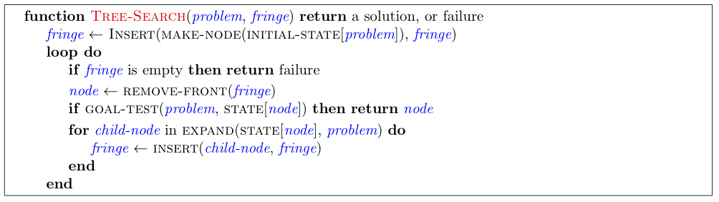
Tree Search Pseudo-Code

Slide 122
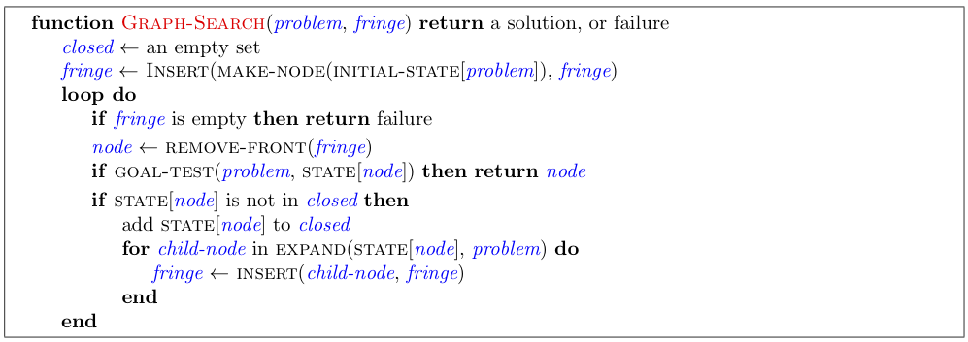
Graph Search Pseudo-Code

Slide 123
Optimality of A* Graph Search
Consider what A* does:
Expands nodes in increasing total f value (f-contours) Reminder: f(n) = g(n) + h(n) = cost to n + heuristic
Proof idea: the optimal goal(s) have the lowest f value, so it must get expanded first
…
f ≤ 1
There’s a problem with this argument. What are we assuming is true?
f ≤ 2
f ≤ 3

Slide 124




Optimality of A* Graph Search
Proof:
New possible problem: some n on path to G* isn’t in queue when we need it, because some worse n’ for the same state dequeued and expanded first (disaster!)
Take the highest such n in tree
Let p be the ancestor of n that was on the queue when n’ was popped
f(p) < f(n) because of consistency
f(n) < f(n’) because n’ is suboptimal
p would have been expanded before n’
Contradiction!

Slide 132
More Search Methods
Local Search
Hill Climbing
Simulated Annealing
Beam Search
Genetic Search
Local Search in Continuous Spaces
Searching with Nondeterministic Actions
Online Search (agent is executing actions)

Slide 133
Local Search Algorithms and Optimization Problems
Complete state formulation
For example, for the 8 queens problem, all 8 queens are on the board and need to be moved around to get to a goal state
Equivalent to optimization problems often found in science and engineering
Start somewhere and try to get to the solution from there
Local search around the current state to decide where to go next

Slide 134
Pose Estimation Example
Given a geometric model of a 3D object and a 2D image of the object.
Determine the position and orientation of the object wrt the camera that snapped the image.
image 3D object
State (x, y, z, x-angle, y-angle, z-angle)

Slide 135
Hill-climbing
Goal: Optimizing an objective function.
Does not require differentiable functions
Can be applied to “goal” predicate type of problems.
BSAT with objective function number of clauses satisfied.
Intuition: Always move to a better state

Slide 136
Hill-Climbing Search
function HILL-CLIMBING(problem) return a state that is a local maximum
input: problem, a problem
local variables: current, a node.
neighbor, a node.
current ← MAKE-NODE(INITIAL-STATE[problem])
loop do
neighbor ← a highest valued successor of current
if VALUE [neighbor] ≤ VALUE[current] then return STATE[current]
current ← neighbor

Slide 137
Some Hill-Climbing Algo’s
Start = random state or special state.
Until (no improvement)
Steepest Ascent: find best successor
OR (greedy): select first improving successor
Go to that successor
Repeat the above process some number of times (Restarts).
Can be done with partial solutions or full solutions.

Slide 138
Hill-climbing
Implicit in this scheme is the notion of a neighborhood that in some way preserves the cost behavior of the solution space…
Think about the TSP problem again
If I have a current tour what would a neighboring tour look like?
This is a way of asking for a successor function.

Slide 139
Hill-climbing Search
The successor function is where the intelligence lies in hill-climbing search
It has to be conservative enough to preserve significant “good” portions of the current solution
And liberal enough to allow the state space to be preserved without degenerating into a random walk

Slide 140
Hill-climbing Algorithm
In Best-first, replace storage by single node
Works if single hill
Use restarts if multiple hills
Problems:
finds local maximum, not global
plateaux: large flat regions (happens in BSAT)
ridges: fast up ridge, slow on ridge
Not complete, not optimal
No memory problems ☺

Slide 141
Hill Climbing
“Gradient ascent”
solution
Note: solutions shown
here as max not min.
Often used for numerical optimization problems.
How does it work?

Slide 142
AI Hill Climbing
Steepest-Ascent Hill Climbing
current ← start node
loop do
neighbor ← a highest-valued successor of current
if neighbor.Value <= current.Value then return current.State
current ← neighbor
end loop

Slide 143
Hill Climbing Search
current
6
4
10
3
2
8
What if current had a value of 12?

Slide 144
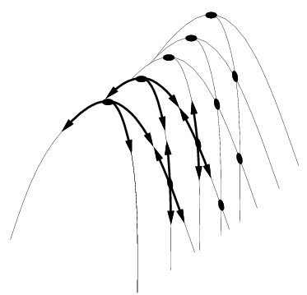
Hill Climbing Problems
Local maxima
Plateaus
Diagonal ridges
What is it sensitive to?
Does it have any advantages?

Slide 145
Local Maxima (Minima)
Hill-climbing is subject to getting stuck in a variety of local conditions…
Two solutions
Stochastic Hill-climbing – chooses random from among the uphill moves
First choice hill-climbing – similar to stochastic but creates successors at random
Random restart hill-climbing – Randomly generates initial states and keep climbing high
Simulated annealing

Slide 146
Random Restart Hillclimbing
Pretty obvious what this is….
Generate a random start state
Run hill-climbing and store answer
Iterate, keeping the current best answer as you go
Stopping… when? – Reaches the goal

Slide 147
Simulated Annealing
Variant of hill climbing (so up is good)
Tries to explore enough of the search space early on, so that the final solution is less sensitive to the start state
May make some downhill moves before finding a good way to move uphill.

Slide 148
Simulated Annealing
Comes from the physical process of annealing in which substances are raised to high energy levels (melted) and then cooled to solid state.
The probability of moving to a higher energy state, instead of lower is
p = e^(-ΔE/kT)
where ΔE is the positive change in energy level, T is the temperature, and k is Bolzmann’s constant.
heat cool

Slide 149
Simulated Annealing
Like hill-climbing, but probabilistically allows down moves, controlled by current temperature and how bad move is.
Let t[1], t[2],… be a temperature schedule.
usually t[1] is high, t[k] = 0.9*t[k-1].
Let E be quality measure of state
Goal: maximize E.

Slide 150
Simulated Annealing Algorithm
Current = random state, k = 1
If T[k] = 0, stop.
Next = random next state
If Next is better than start, move there.
If Next is worse:
Let Delta = E(next)-E(current)
Move to next with probabilty e^(Delta/T[k])
k = k+1

Slide 151
Simulated Annealing Discussion
No guarantees
When T is large, e^delta/t is close to e^0, or 1. So for large T, you go anywhere.
When T is small, e^delta/t is close to e^-inf, or 0. So you avoid most bad moves.
After T becomes 0, one often does simple hill-climbing.
Execution time depends on schedule; memory use is trivial.

Slide 152
Simulated Annealing
At the beginning, the temperature is high.
As the temperature becomes lower
kT becomes lower
ΔE/kT gets bigger
(-ΔE/kT) gets smaller
e^(-ΔE/kT) gets smaller
As the process continues, the probability of a downhill move gets smaller and smaller.

Slide 153
For Simulated Annealing
ΔE represents the change in the value of the objective function.
Since the physical relationships no longer apply, drop k. So p = e^(-ΔE/T)
We need an annealing schedule, which is a sequence of values of T: T₀, T₁, T₂, ...

Slide 154
Simulated Annealing Algorithm
current ← start node;
for each T on the schedule /* need a schedule */
next ← randomly selected successor of current
evaluate next; it it’s a goal, return it
ΔE ← next.Value – current.Value /* already negated */
if ΔE > 0
then current ← next /* better than current */
else current ← next with probability e^(ΔE/T)
How would you do this probabilistic selection?

Slide 155
Simulated annealing
function SIMULATED-ANNEALING( problem, schedule) return a solution state
input: problem, a problem
schedule, a mapping from time to temperature
local variables: current, a node.
next, a node.
T, a “temperature” controlling the probability of downward steps
current ← MAKE-NODE(INITIAL-STATE[problem])
for t ← 1 to ∞ do
T ← schedule[t]
if T = 0 then return current
next ← a randomly selected successor of current
∆E ← VALUE[next] - VALUE[current]
if ∆E > 0 then current ← next
else current ← next only with probability e^{∆E /T}

Slide 156
Properties of simulated annealing search
One can prove: If T decreases slowly enough, then simulated annealing search will find a global optimum with probability approaching 1
Widely used in VLSI layout, airline scheduling, etc

Slide 157
Probabilistic Selection
Select next with probability p
Generate a random number
If it’s <= p, select next
p
0 1
random
number

Slide 158
Simulated Annealing Properties
At a fixed “temperature” T, state occupation probability reaches the Boltzman distribution
If T is decreased slowly enough (very slowly), the procedure will reach the best state.
Slowly enough has proven too slow for some researchers who have developed alternate schedules.
p(x) = αe^(E(x)/kT)

Slide 159
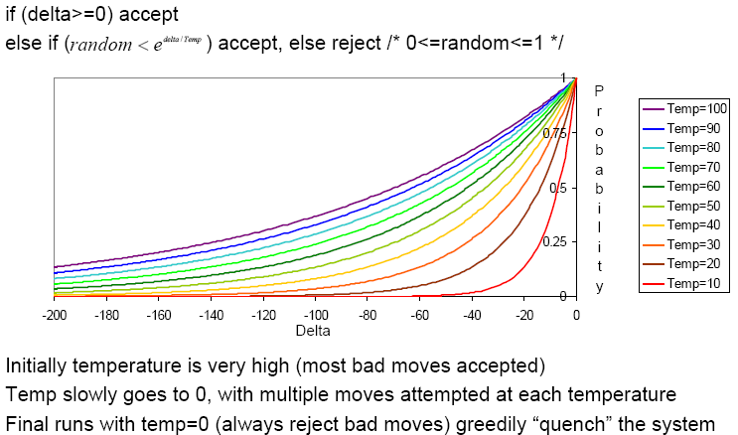
Simulated Annealing Schedules
Acceptance criterion and cooling schedule

Slide 160
Simulated Annealing Applications
Basic Problems
Traveling salesman
Graph partitioning
Matching problems
Graph coloring
Scheduling
Engineering
VLSI design
Placement
Routing
Array logic minimization
Layout
Facilities layout
Image processing
Code design in information theory

Slide 161
Beam
Mix of hill-climbing and best first
Storage is a cache of best K states
Solves storage problem, but…
Not optimal, not complete

Slide 162
Local Beam Search
Keeps more previous states in memory
Simulated annealing just kept one previous state in memory.
This search keeps k states in memory.
- randomly generate k initial states
- if any state is a goal, terminate
- else, generate all successors and select best k
- repeat
Pros? Cons?

Slide 163
Local (Iterative) Improving
Initial state = full candidate solution
Greedy hill-climbing:
if up, do it
if flat, probabilistically decide to accept move
if down, don’t do it
We are gradually expanding the possible moves.

Slide 164
Local Improving: Performance
Solves 1,000,000 queen problem quickly
Useful for scheduling
Useful for BSAT
solves (sometimes) large problems
More time, better answer
No memory problems
No guarantees of anything

Slide 165
Genetic Algorithm
Weakly analogous to “evolution”
No theoretic guarantees
Applies to nearly any problem.
Population = set of individuals
Fitness function on individuals
Mutation operator: new individual from old one.
Cross-over: new individuals from parents

Slide 166
GA Algorithm (a version)
Population = random set of n individuals
Probabilistically choose n pairs of individuals to mate
Probabilistically choose n descendants for next generation (may include parents or not)
Probability depends on fitness function as in simulated annealing.
How well does it work? Good question ☺

Slide 167
Scores to Probabilities
Suppose the scores of the n individuals are:
a[1], a[2],….a[n].
The probability of choosing the jth individual
prob = a[j]/(a[1]+a[2]+….a[n]).

Slide 168
GA Example
Problem Boolean Satisfiability.
Individual = bindings for variables
Mutation = flip a variable
Cross-over = For 2 parents, randomly positions from 1 parent. For one son take those bindings and use other parent for others.
Fitness = number of clauses solved.

Slide 169
GA Example
N-queens problem
Individual: array indicating column where ith queen is assigned.
Mating: Cross-over
Fitness (minimize): number of constraint violations

Slide 170
GA Function Optimization Ex.
Let f(x,y) be the function to optimize.
Domain for x and y is real number between 0 and 10.
Say the hidden function is:
f(x,y) = 2 if x> 9 & y>9.
f(x,y) = 1 if x>9 or y>9
f(x,y) = 0 otherwise.

Slide 171
GA Works Well here.
Individual = point = (x,y)
Mating: something from each so:
mate({x,y},{x’,y’}) is {x,y’} and {x’,y}.
No mutation
Hill-climbing does poorly, GA does well.
This example generalizes functions with large arity.

Slide 172
GA Discussion
Reported to work well on some problems.
Typically not compared with other approaches, e.g. hill-climbing with restarts.
Opinion: Works if the “mating” operator captures good substructures.
Any ideas for GA on TSP?

Slide 173
Genetic Algorithms
Start with random population of states
Representation serialized (ie. strings of characters or bits)
States are ranked with “fitness function”
Produce new generation
Select random pair(s) using probability:
probability ~ fitness
Randomly choose “crossover point”
Offspring mix halves
Randomly mutate bits
Crossover Mutation
174629844710
174611094281
164611094281
→
→
776511094281
776529844710
776029844210

Slide 174
Genetic Algorithm
Given: population P and fitness-function f
repeat
newP ← empty set
for i = 1 to size(P)
x ← RandomSelection(P,f)
y ← RandomSelection(P,f)
child ← Reproduce(x,y)
if (small random probability) then child ← Mutate(child)
add child to newP
P ← newP
until some individual is fit enough or enough time has elapsed
return the best individual in P according to f

Slide 175
Using Genetic Algorithms
2 important aspects to using them
1. How to encode your real-life problem
2. Choice of fitness function
Research Example
We want to generate a new operator for finding interesting points on images
The operator will be some function of a set of values v₁, v₂, … v_{K}.
Idea: weighted sums, weighted mins, weighted maxs. a₁,…a_{K},b₁,…b_{K},c₁,…c_{k}

Slide 176
Local Search in Continuous Spaces
Given a continuous state space
S = {(x₁,x₂,…,x_{N}) | x_{i} ε R}
Given a continuous objective function f(x₁,x₂,…,x_{N})
The gradient of the objective function is a vector ∇f = (∂f/∂x₁,∂f/∂x₂,…,∂f/∂x_{N})
The gradient gives the magnitude and direction of the steepest slope at a point.

Slide 177
Local Search in Continuous Spaces
To find a maximum, the basic idea is to set ∇f =0
Then updating of the current state becomes
x ← x + α∇f(x)
where α is a small constant.
Theory behind this is taught in numerical methods classes.
Your book suggests the Newton-Raphson method. Luckily there are packages…..

Slide 178
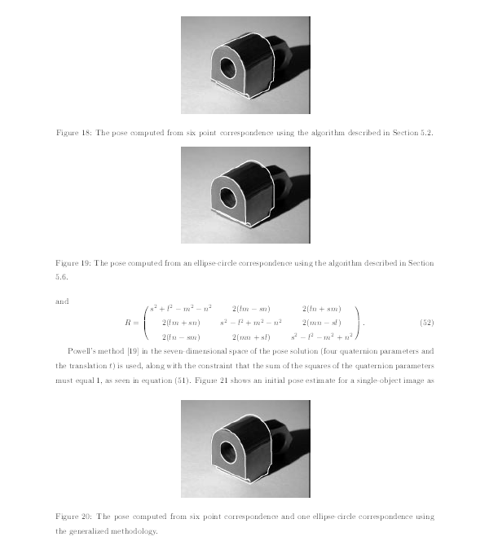
Computer Vision Pose Estimation Example

Slide 179

Computer Vision Pose Estimation Example
Read the “Airports in Romania” example in the text.

Slide 180
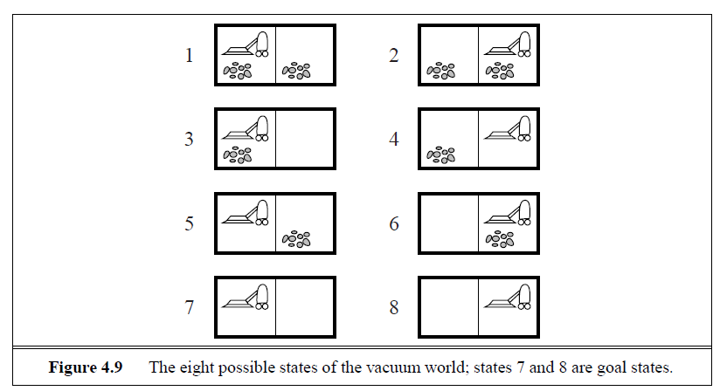
Searching with Nondeterministic Actions
Vacuum World (actions = {left, right, suck})

Slide 181
Searching with Nondeterministic Actions
In the nondeterministic case, the result of an action can vary.
Erratic Vacuum World:
When sucking a dirty square, it cleans it and sometimes cleans up dirt in an adjacent square.
When sucking a clean square, it sometimes deposits dirt on the carpet.

Slide 182
Generalization of State-Space Model
Generalize the transition function to return a set of possible outcomes.
oldf: S x A -> S newf: S x A -> 2^{S}
2. Generalize the solution to a contingency plan.
if state=s then action-set-1 else action-set-2
3. Generalize the search tree to an AND-OR tree.

Slide 183
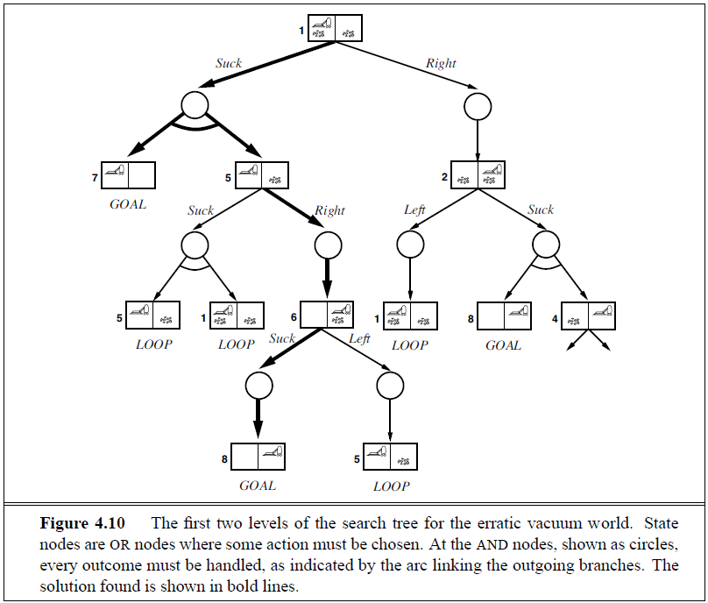
AND-OR Search Tree
OR
Node
AND
Node

Slide 184
Searching with Partial Observations
The agent does not always know its state!
Instead, it maintains a belief state: a set of possible states it might be in.
Example: a robot can be used to build a map of a hostile environment. It will have sensors that allow it to “see” the world.

Slide 185
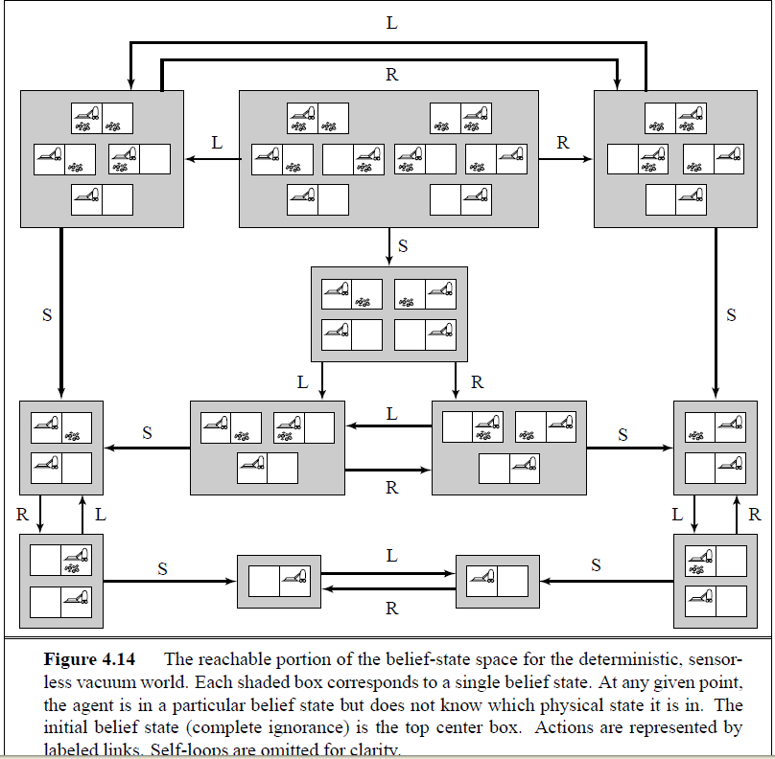
Belief State Space for Sensorless Agent
initial state
Knows it’s
on the left
Knows it’s
on the right.
Knows left
side clean

Slide 186
Online Search Problems
Active agent
executes actions
acquires percepts from sensors
deterministic and fully observable
has to perform an action to know the outcome
Examples
Web search
Autonomous vehicle

